Slide 1
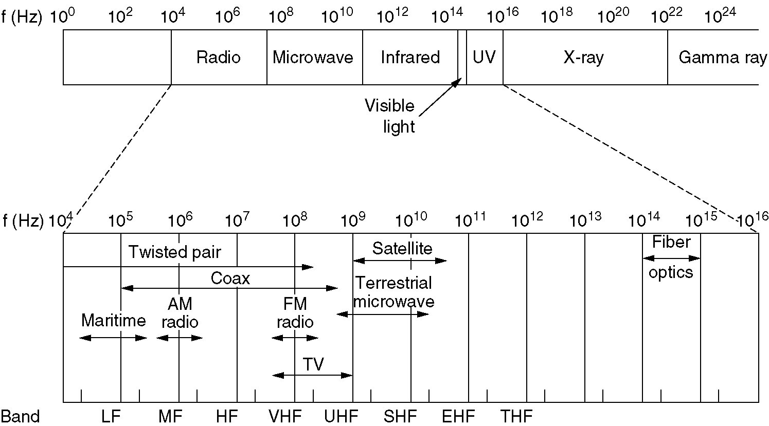
The Electromagnetic Spectrum
The electromagnetic spectrum and its uses for communication.

Slide 2
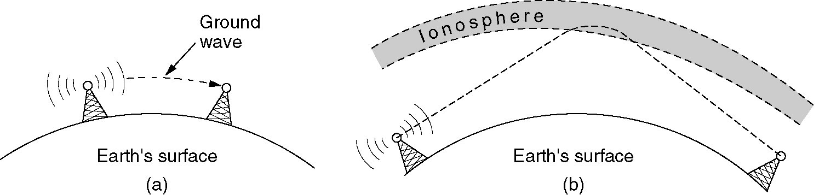
Radio Transmission
(a) In the VLF, LF, and MF bands, radio waves follow the curvature of the earth.
(b) In the HF band, they bounce off the ionosphere.

Slide 3
Microwave Transmission
Waves > 100 MHz travel in nearly straight lines and can be focused

Slide 4
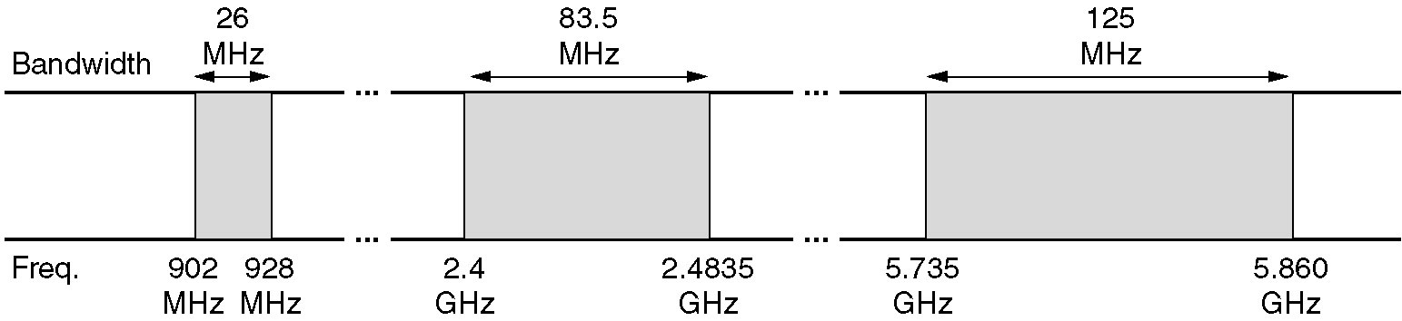
US Unlicensed Frequency Ranges

Slide 5
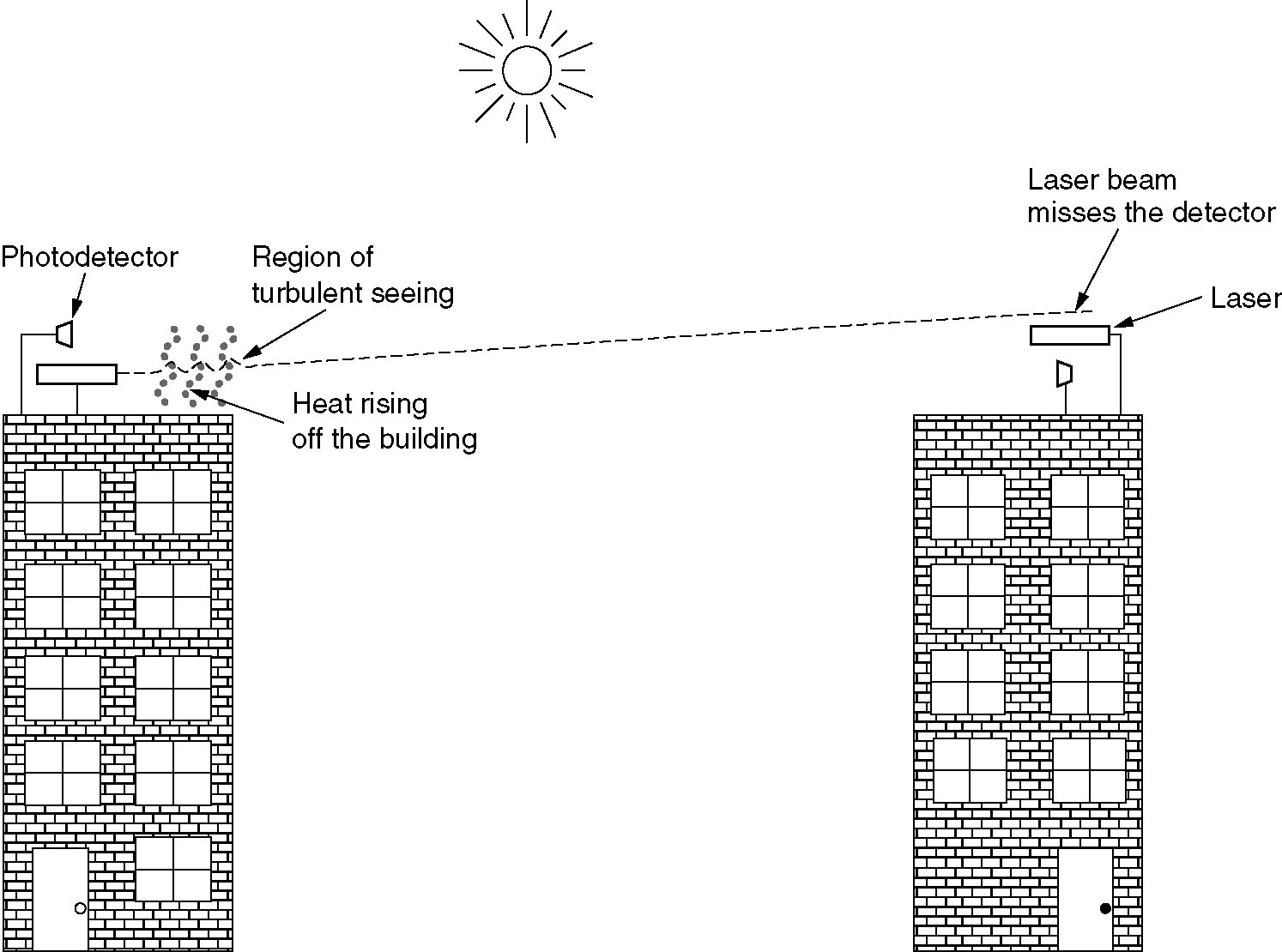
Lightwave Transmission
Example: used to connect LANs in two buildings via lasers
  Bidirectional system with two lasers is pictured here
Convection currents can interfere with laser communication systems

Slide 6
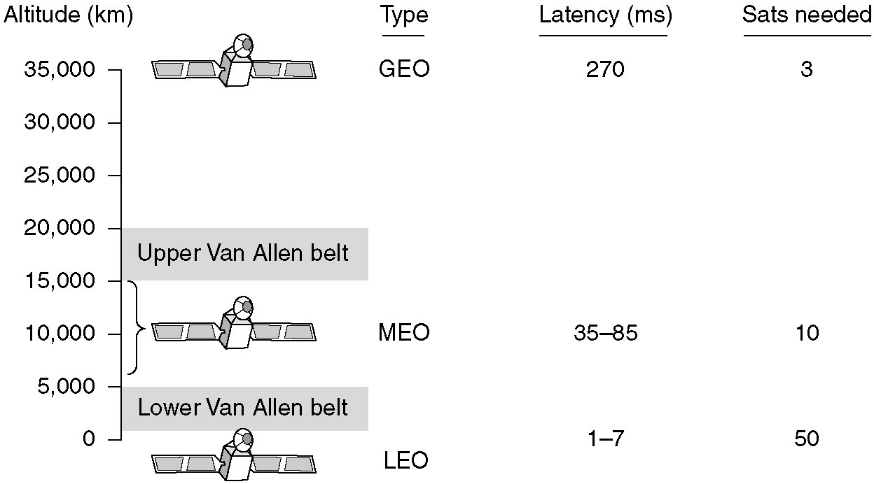
Communication Satellites
Communication satellites and some of their properties, including altitude above the Earth, round-trip delay time and number of satellites needed for global coverage

Slide 7
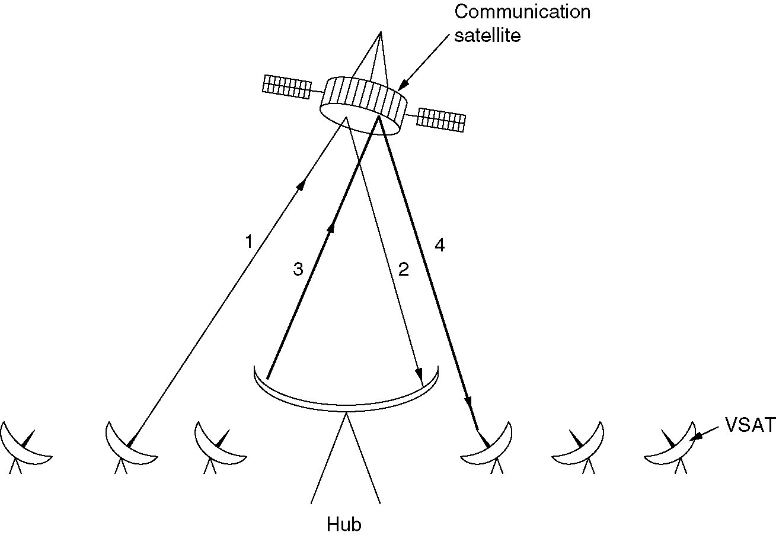
Geostationary Satellite Example
Very Small Aperture Terminals (VSAT)
  Low cost microstations
  Specifications: ≤ 1m antennas with 1 Watt output power
  Require hubs to communicate between satellites in VSAT systems
  Uplink capability: 19.2 kbps
  Downlink capability: 512 kbps
  Example usage: direct broadcast satellite TV

Slide 8
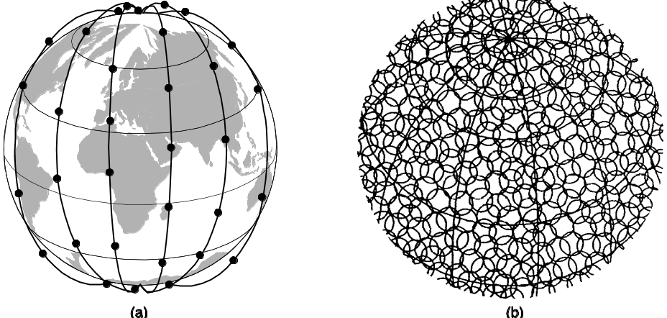
Low-Earth Orbit Satellites
Iridium
  Deployed in 1997
  Worldwide telecommunications service using hand-held devices that communicate with the satellites
  www.iridium.com

Slide 9
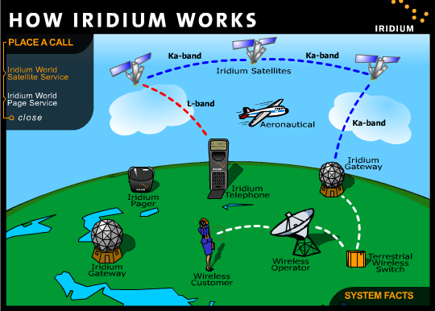
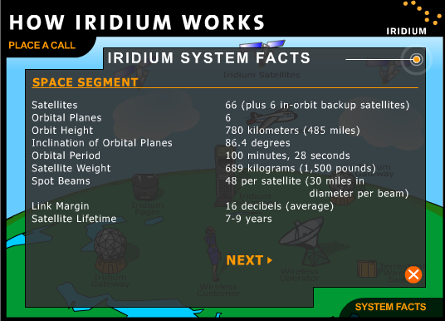
Iridium

